Slide 1

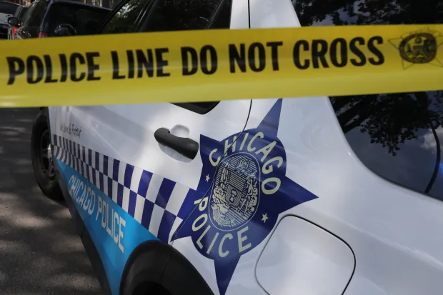
DA PAT DOWN
A FILM BY JULIAN VANN

Slide 2
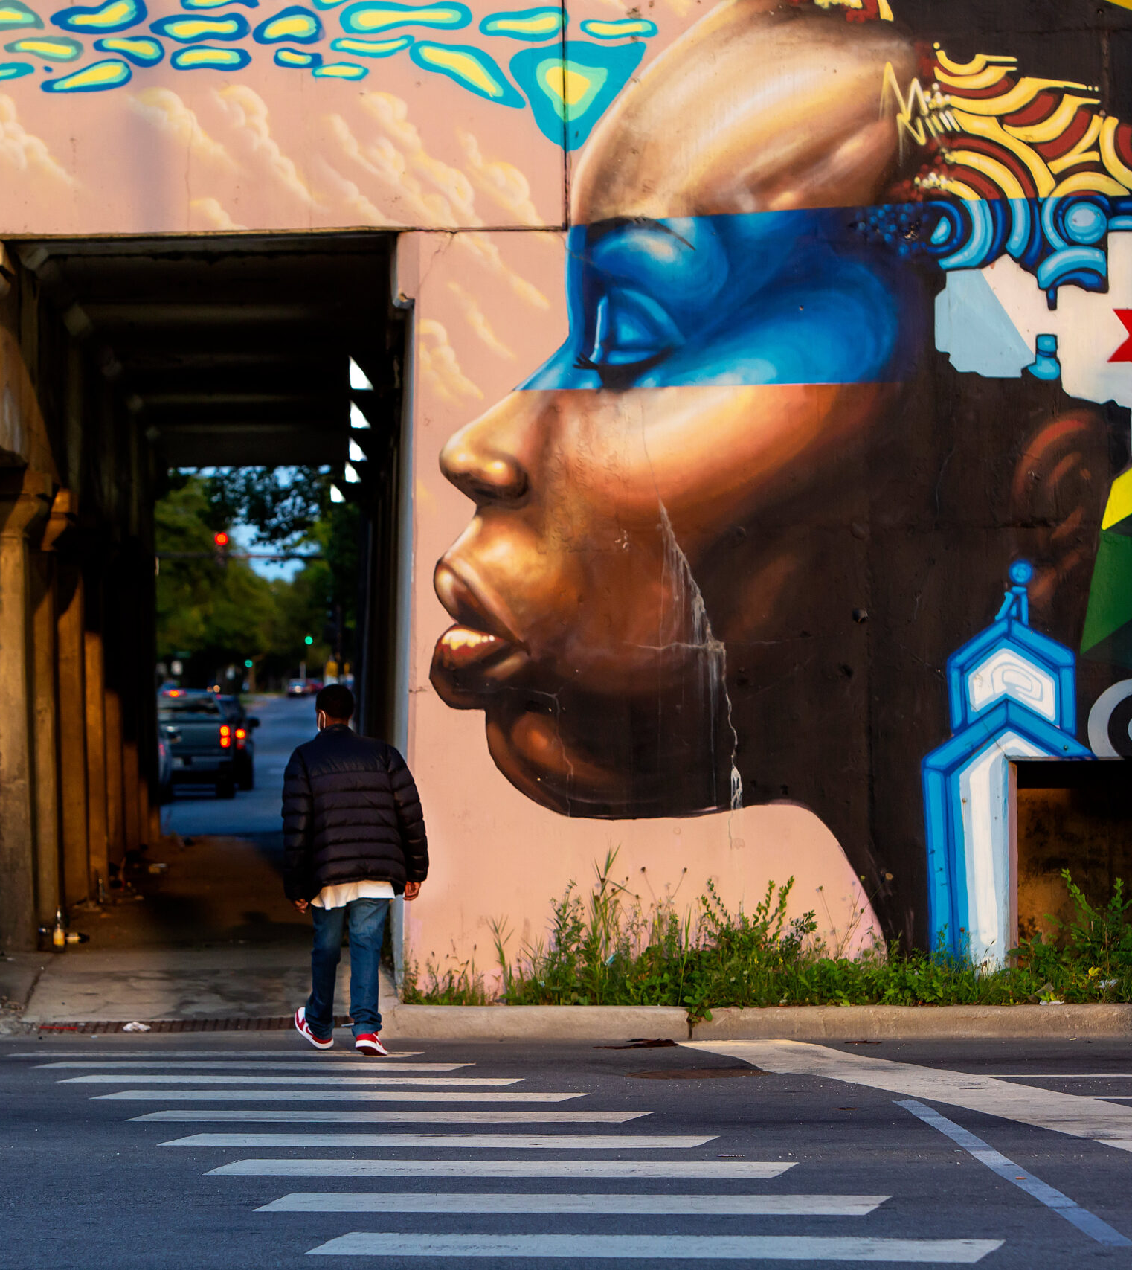
Table of content
1) EXECUTIVE SUMMARY
2) THE STORY
3) POTENTIAL CAST
4)PRODUCTION TEAM
5) PRODUCTION TIMELINE

Slide 3
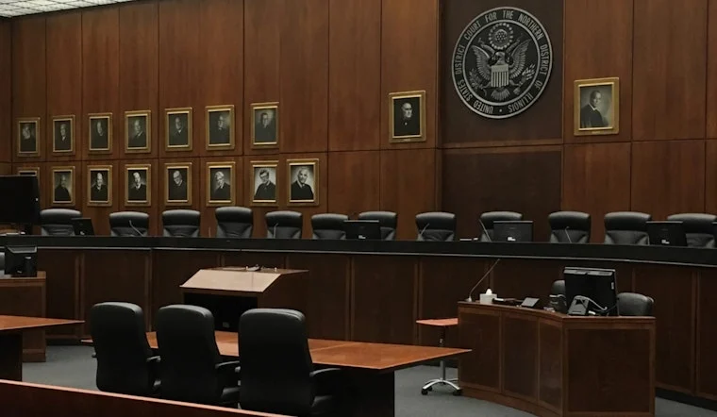
Executive Summary
The purpose of this business plan is to outline an actionable course for the successful completion, marketing, and distribution of the feature-length film, Da Pat Down.
LOGLINE
A once esteemed Chicago Tactical officers now struggling with justice attempts to cover up his crimes before being indictment by any means necessary.
CASTING
In the process of securing letters of intent for the lead roles of Detective Kirk, Detective Bryant, and Darnell. Talent is also being approached for several of the top supporting roles in the film. Cast are being sought based on artistic sensibilities, bankability and marketing awareness.
FINANCING
The financial requirement for this plan is $0-80k. $0-80k will provide for the development, production, and post-production deliverables for the film. The structure allows for both a traditional distribution path of an acquisition deal as well as a self-motivated release strategy of the film.
SALES
Would like to engage in discussions to attach strong international sales representation to present Da Pat Down globally at major film markets. The budget for the proposed film has been designed with the financial return in mind and has been structured to be flexible amidst any unforeseen landscape. The return strategy is based on a practical plan for accessing traditional urban and drama film markets. Additionally, The Production team will position the film towards individuals looking for a new, drama thriller full of surprising twists, crime elements, and a unique cast of characters. Theatrical, New Media, Streaming Video on Demand (SVOD), DVD/Blu-Ray, broadcast, and foreign distribution outlets will be pursued—each with specific intent.

Slide 4

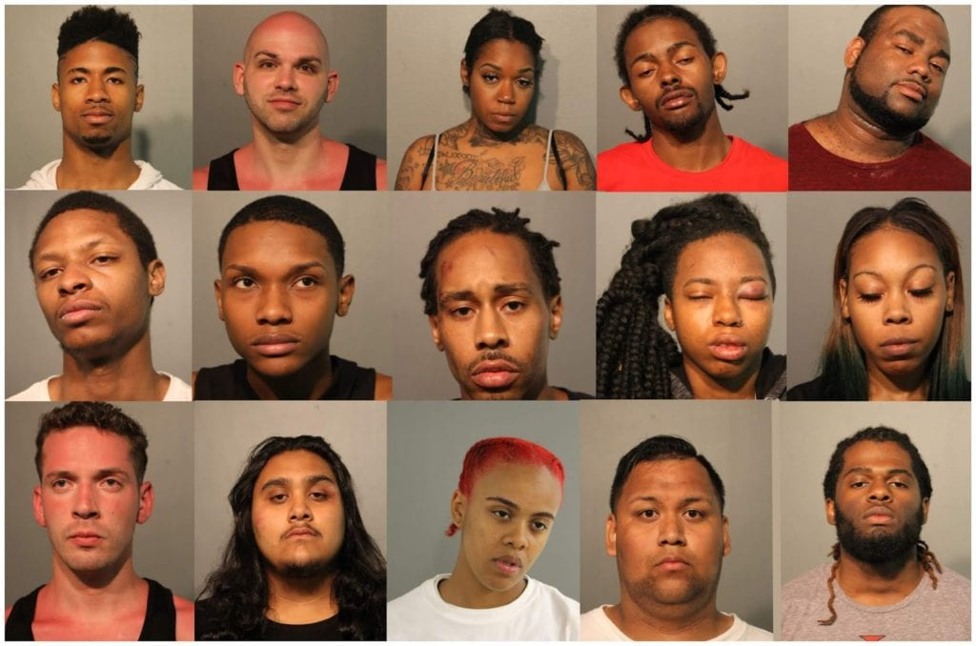
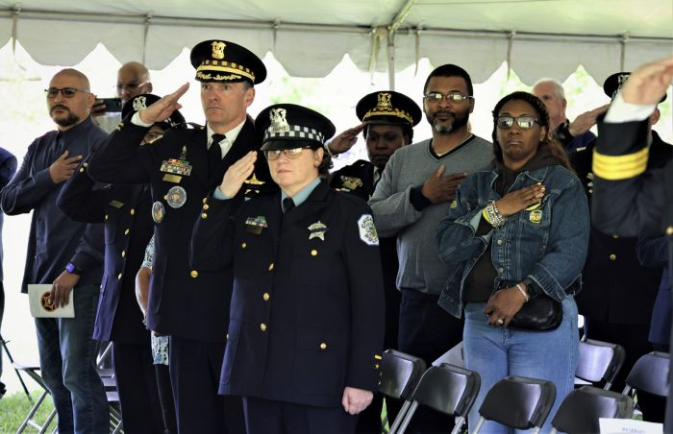
After the random killing of his daughter, detective kirk’s life spiraled out of control centered around drug rings & robbery. The only person detective kirk can trust is his partner to help clean up his mess. With Pressure from the department to make a connection Lieutenant weston who is also detective kirks ex-wife an supervisor still struggles to move on from their daughter's death. After uncovering all the details to these murders related drug ring arrest detective kirk for his crimes
THE STORY

Slide 5
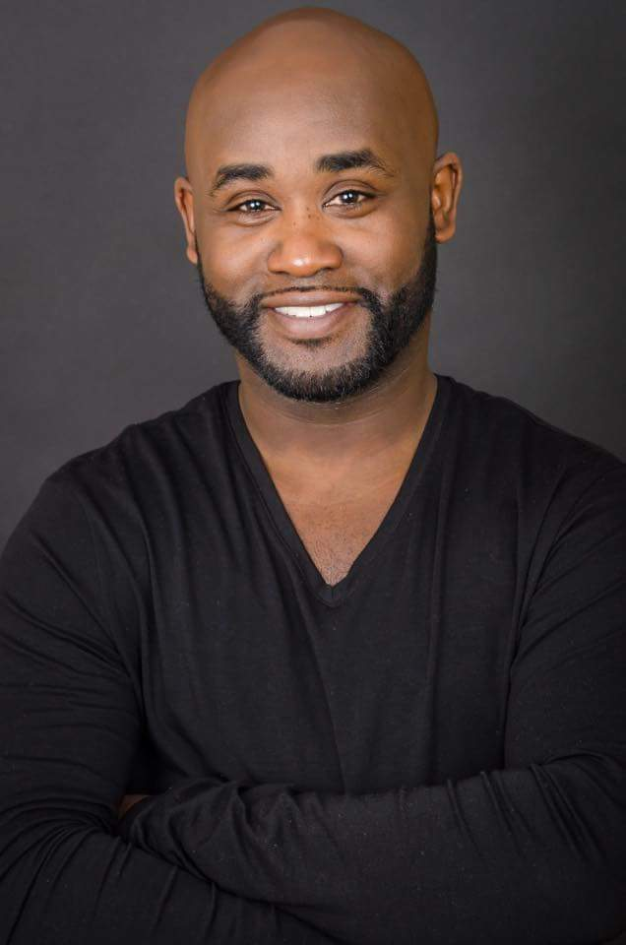
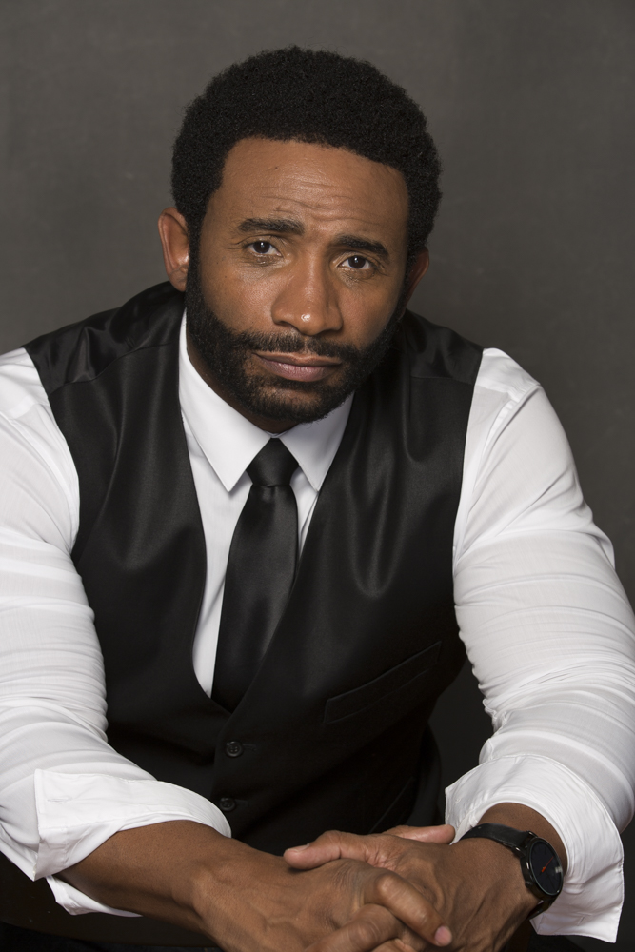

Eric Lane
POTENTIAL CAST
Lance Gross
Tray Chaney

Slide 6


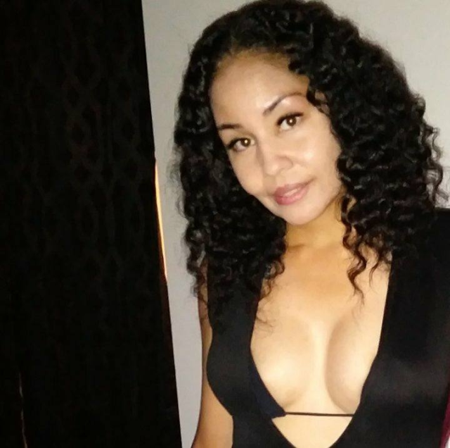
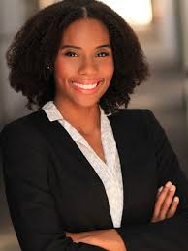
Angell Conwell
Dotti Staxx
Candice Marie Singleton

Slide 7
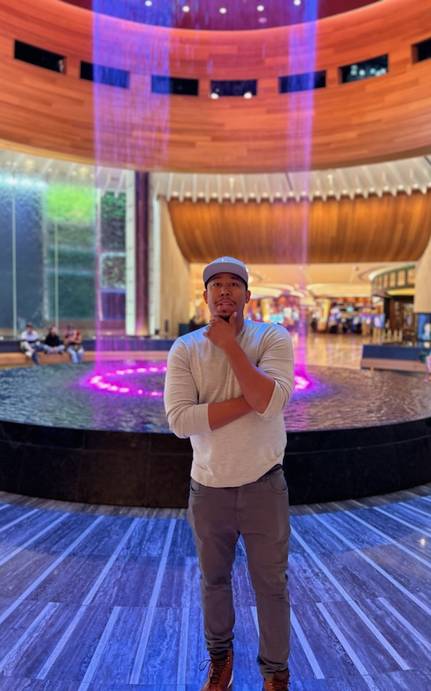
Production team
Julian Vann is an writer/director/producer out of Chicago, IL. He has been directing an producing for more than 4 years with over 15 years of writing experience.
Julian wrote /produce & directed the movie “Get da Big Bag”. Currently on Tubi
Wrote the film “Sidewayz Collections”. Previously on Tubi. Now on Youtube.
Wrote the book “Love is wrong & Love is right”. Currently on Amazon
Prior to Writing an directing Julian has been an accountant for 16 years.
Julian Vann
Writer/Producer

Slide 8
PRODUCTION TIMELINE
Development soon to begin
Featuring
Pre-Production (2-3 Weeks)
• Fully develop the shooting script
• Complete preliminary shooting schedule
• Complete preliminary budget
• Secure preliminary talent commitments
• Secure project funding
• Set up production offices and accounting department
• Final casting, cast rehearsals, fittings
• Inform major and mini-major distributors of production status and establish tracking procedures
• Hire complete production team and crew
• Adjust and finalize production schedule and budget
• Complete all production design planning
• Book all equipment according to schedule
• Complete location scouting, contracting, and permitting
• Engage music licensing and pre-recording
• Book all travel and arrangements according to schedule and agreements
Principal Photography (2-3 Weeks)
Post Production (7-8 Weeks)
• Engage in all activities involving picture and field sound acquisition on a twenty-day shooting schedule
• Schedule and execute any needed pickup shots and/or reshoots
• Wrap all outstanding business issues and ensure documentation is complete
• Finalize all accounting for audit
• Finalize, document, and back up all creative assets for post-production
• Complete editorial of film
• Engage music scoring and record score
• Engage sound design including all Foley and looping activities
• Complete all digital effects and color correction
• Schedule and execute test screenings and collect data appropriately
• Make adjustments to final edit based on test screening data
• Mix and master final sound and picture for Dolby mix and/or THX Digital Master
• Complete all deliverables for domestic and foreign release including sound, music, trailer, print (film and digital), DVD, publicity, and legal requirements

Slide 9

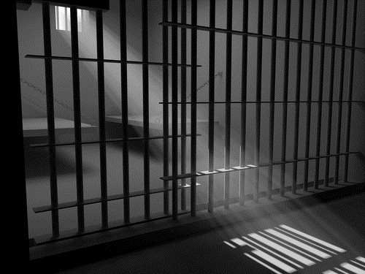
THANK YOU
Thank you
Sincerely,
Julian Vann

